Slide 1

Recent SEC Staff Observations on XBRL Submissions by Corporate Issuers
Scott W. Bauguess Deputy Chief Economist U.S. Securities and Exchange Commission
September 26, 2014

Slide 2
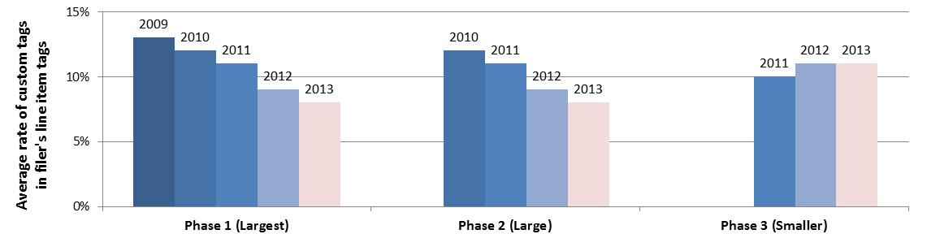
XBRL Custom Tag Rates
Average Custom Tag Rates by Year (Primary Financial Statements)
for corporate issuers that file periodic reports with the SEC
Estimates for years 2009 through 2012 are based on a sample of filings submitted in the respective year. 2013 estimates are based on the most recent 2013 filings as of October 30, 2013. http://www.sec.gov/dera/reportspubs/assessment-custom-tag-rates-xbrl.html

Slide 3
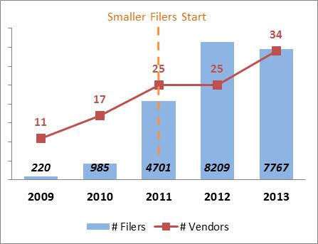
Growth in XBRL Services
Third-Party XBRL Service Provider Increase by Year
Estimates for years 2009 through 2012 are based on a sample of filings submitted in the respective year. 2013 estimates are based on the most recent 2013 filings as of October 30, 2013. http://www.sec.gov/dera/reportspubs/assessment-custom-tag-rates-xbrl.html

